Slide 1
ATSSG
Julie Kaplan Evelyn Moss Tom Shkurti James Talbott

Slide 2
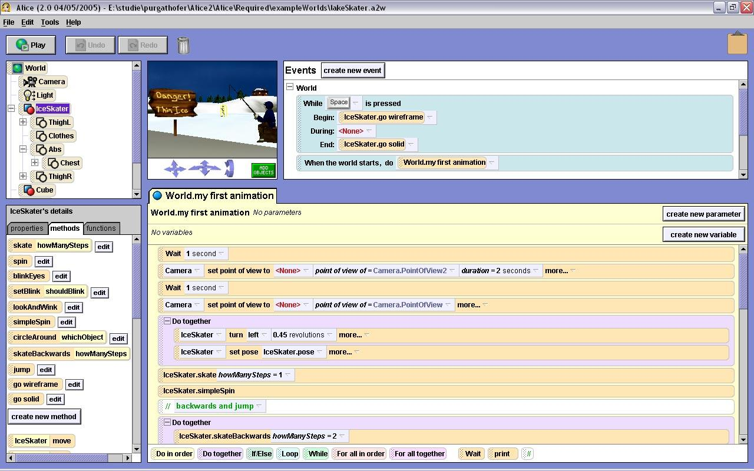
What is ATSSG?
Alice-Type Scripted Strategy Game
Teach middle to high school students basic programming concepts
Turn-based strategy game
Manage complex unit actions via graphical scripting language

Slide 3
Features
Queue units to perform orders at the end of turn.
Load & Save game states.
Customizable and configurable maps.
Create scripts using internal programming language to handle micromanagement.
Custom Engine

Slide 4
Architecture- Overview
Detail Cards
Player
Menu
Main Map
GameMap
Action
AI
Unit

Slide 5
Architecture - Salient Points
Enums allow easy addition of mechanical elements
View-Model segregation in GameMap and MainMap
AI and human players are subclasses of Player which produce Action lists
Modular GUI, game mechanics, and AI

Slide 6
Tools & Software
Github: Version Control & Bug Tracking
JUnit: Unit Tests
Antlr: Script Parsing
EcLemma: Code Coverage

Slide 7
Demo

Slide 8
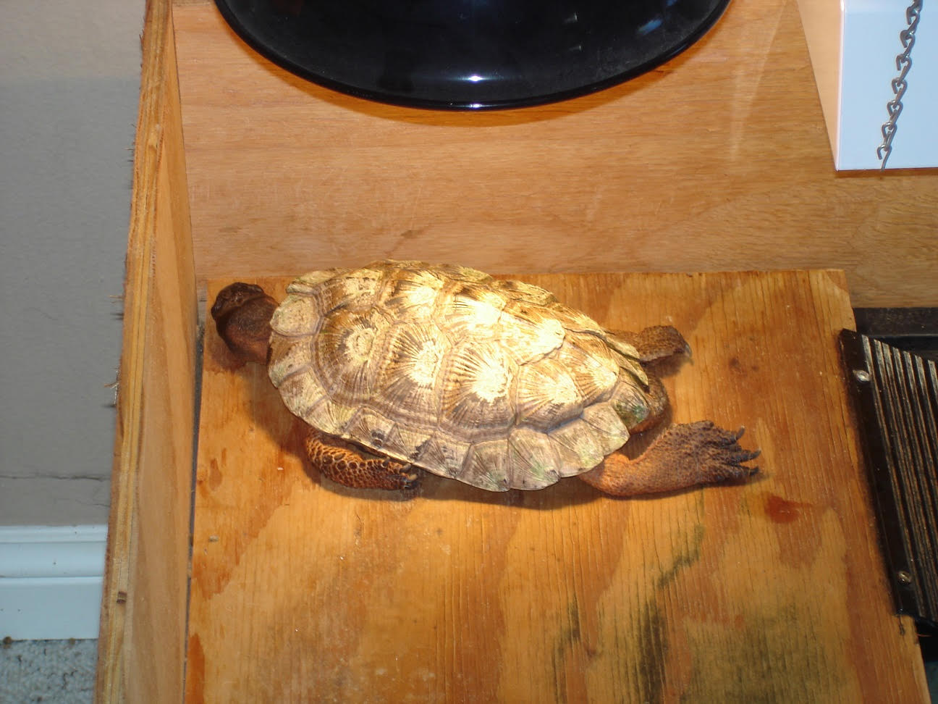
Questions?

